Slide 1


Lecture 2-4
DLI
Iterative Methods for multiple roots

Slide 2
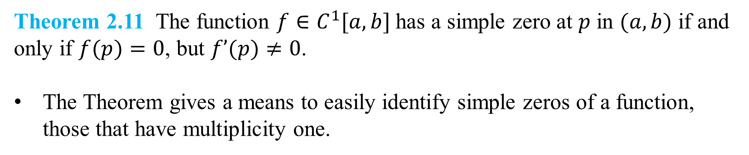
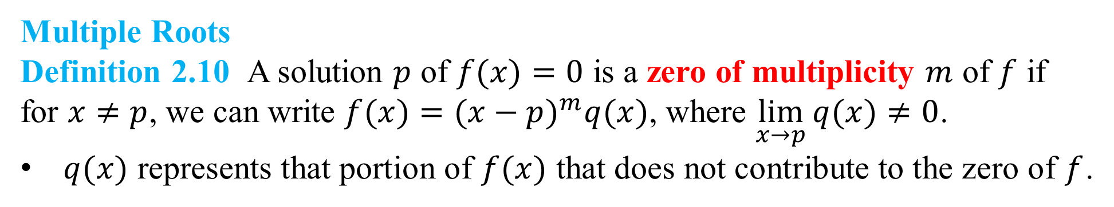
DLI
Multiple Roots
Definition 2.10 A solution $p$ of $f(x)=0$ is a zero of multiplicity $m$ of $f$ if for $x≠p$, we can write $f(x)=(x−p)^{m}q(x)$, where $\lim_{x→p}{q(x)≠0}$.
$q(x)$ represents that portion of $f(x)$ that does not contribute to the zero of $f$.
Theorem 2.11 The function $f∈C^{1}[a,b]$has a simple zero at $p$ in $(a,b)$ if and only if $f(p)=0$, but $f’(p)≠0$.
The Theorem gives a means to easily identify simple zeros of a function, those that have multiplicity one.

Slide 3
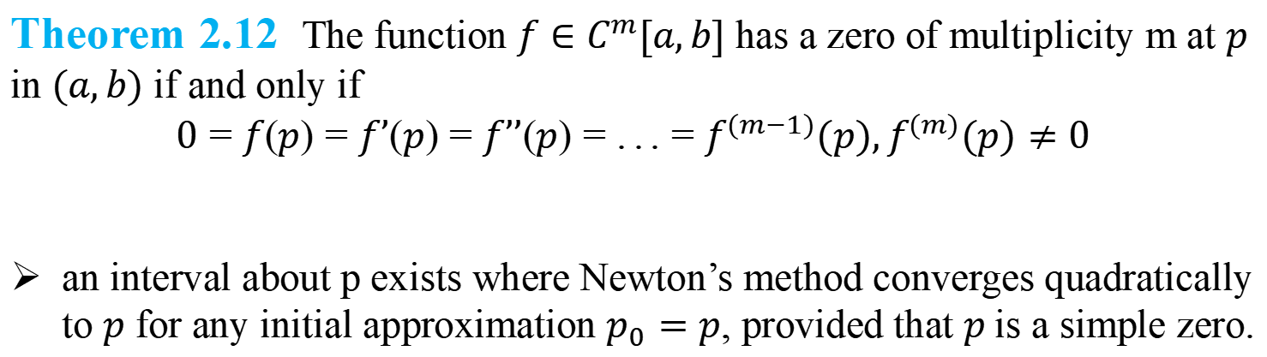
DLI
Theorem 2.12 The function $f∈C^{m}[a,b]$ has a zero of multiplicity m at $p$ in $(a,b)$ if and only if
$$0=f(p)=f’(p)=f’’(p)=...=f^{(m−1)}(p),f^{(m)}(p)≠0$$
an interval about p exists where Newton’s method converges quadratically to $p$ for any initial approximation $p_{0}=p$, provided that $p$is a simple zero.

Slide 4
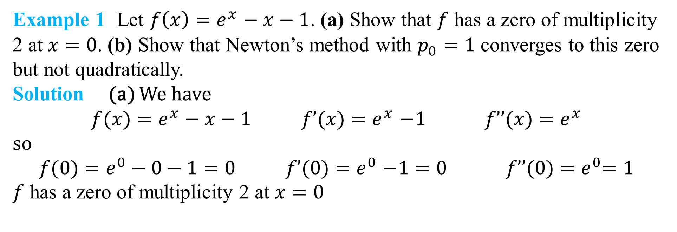
DLI
Example 1 Let $f\left(x\right)=e^{x}−x−1$. (a) Show that $f$ has a zero of multiplicity 2 at $x=0$. (b) Show that Newton’s method with $p_{0}=1$ converges to this zero but not quadratically.
Solution (a) We have
$$f(x)=e^{x}−x−1 f’(x){=e}^{x}−1 f’’(x){=e}^{x}$$
so
$$f(0)=e^{0}−0−1=0 f’(0){=e}^{0}−1=0 f’’(0){=e}^{0}=1$$
$f$ has a zero of multiplicity 2 at $x=0$

Slide 5
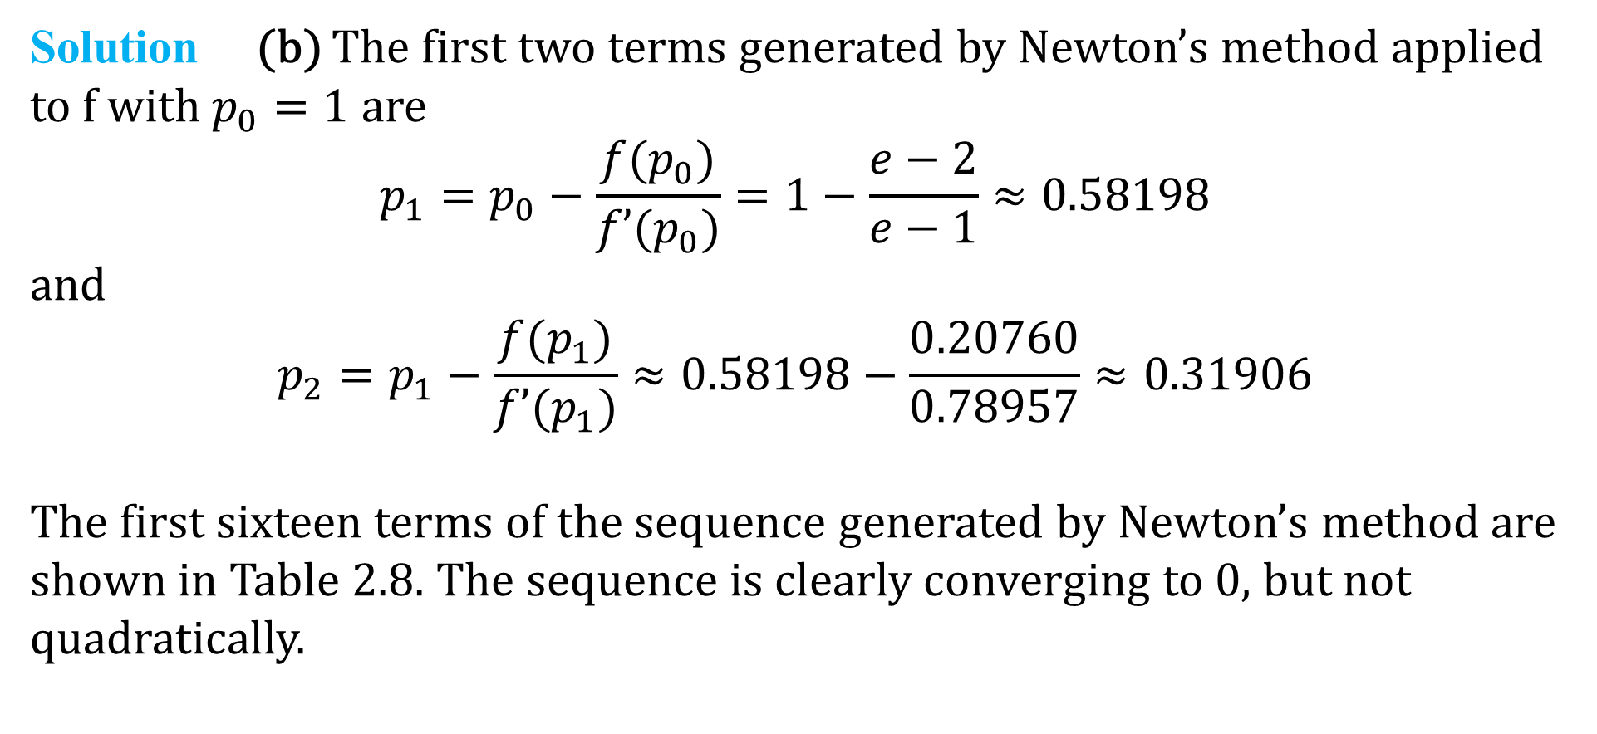
DLI
Solution (b) The first two terms generated by Newton’s method applied to f with$p_{0}=1$ are
$$p_{1}=p_{0}−\frac{f(p_{0})}{f’(p_{0})}=1−\frac{e−2}{e−1}≈0.58198$$
and
$$p_{2}=p_{1}−\frac{f(p_{1})}{f’(p_{1})}≈0.58198−\frac{0.20760}{0.78957}≈0.31906$$
The first sixteen terms of the sequence generated by Newton’s method are shown in Table 2.8. The sequence is clearly converging to 0, but not quadratically.

Slide 6
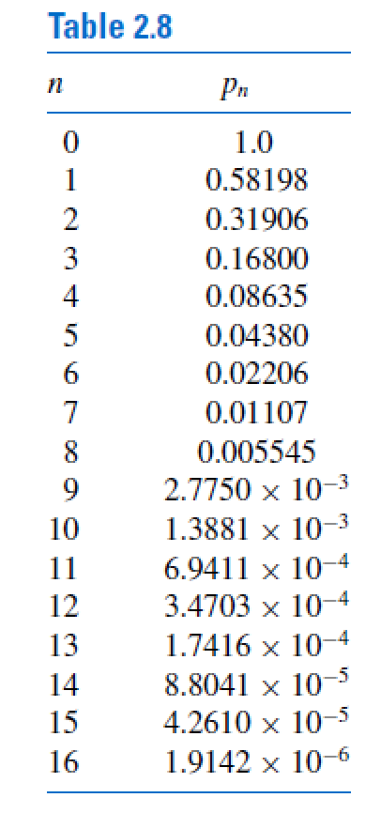
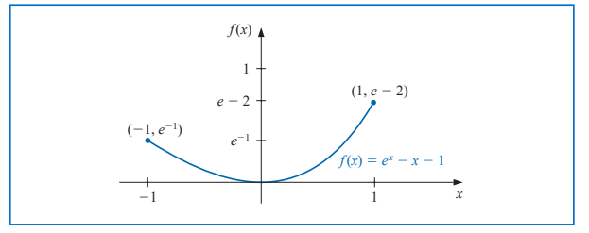
DLI
The example shows that quadratic convergence might not occur if the zero is not simple.

Slide 7
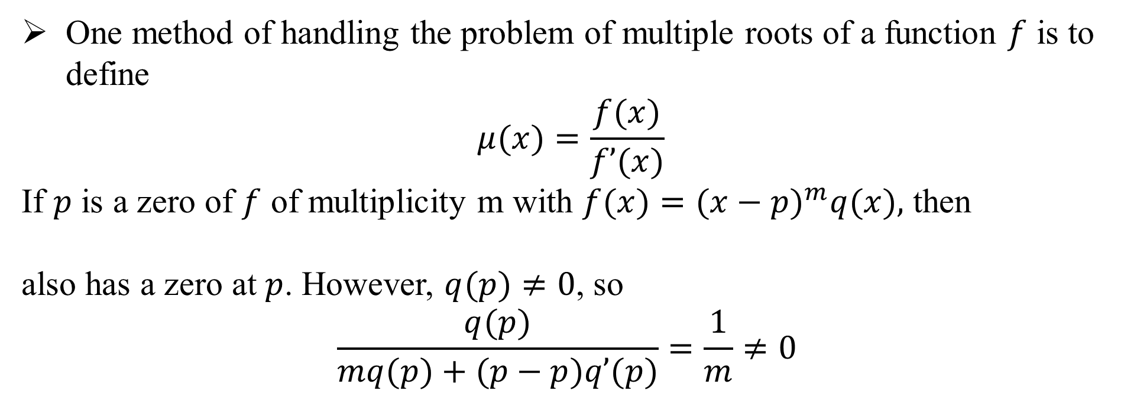
DLI
One method of handling the problem of multiple roots of a function $f$ is to define
$$μ(x)=\frac{f(x)}{f’(x)}$$
If $p$ is a zero of $f$ of multiplicity m with $f(x)=(x−p)^{m}q(x),$ then
also has a zero at $p$. However, $q(p)≠0$, so
$$\frac{q(p)}{mq(p)+(p−p)q’(p)}=\frac{1}{m}≠0$$

Slide 8
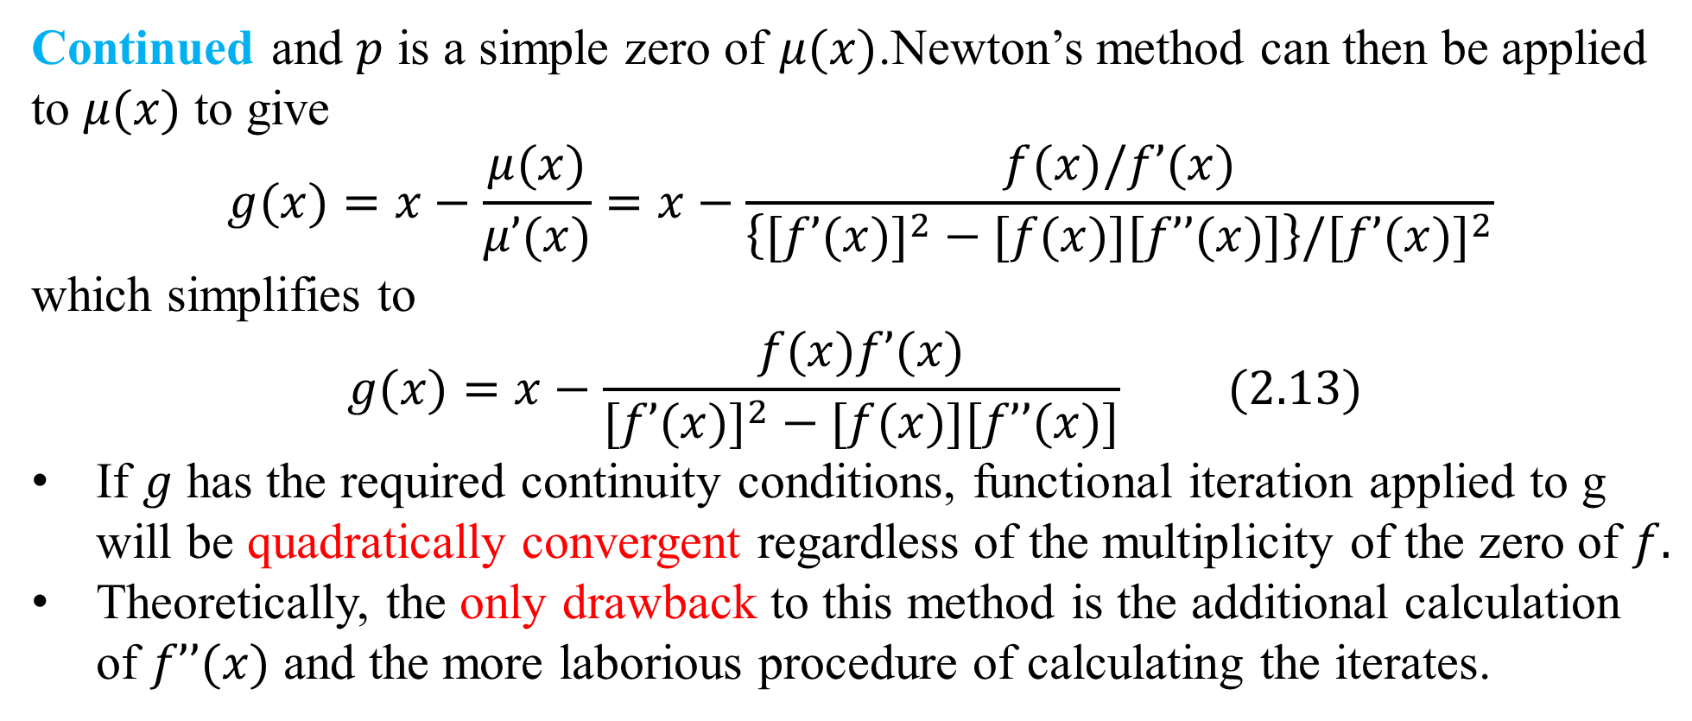
DLI
Continued and $p$ is a simple zero of $μ(x)$.Newton’s method can then be applied to $μ(x)$ to give
$$g(x)=x−\frac{μ(x)}{μ’(x)}=x−\frac{f(x)/f’(x)}{\left\{[f’(x)]^{2}−[f(x)][f’’(x)]\right\}/[f’(x)]^{2}}$$
which simplifies to
$$g(x)=x−\frac{f(x)f’(x)}{[f’(x)]^{2}−[f(x)][f’’(x)]} (2.13)$$
If $g$ has the required continuity conditions, functional iteration applied to g will be quadratically convergent regardless of the multiplicity of the zero of $f.$
Theoretically, the only drawback to this method is the additional calculation of $f’’(x)$ and the more laborious procedure of calculating the iterates.

Slide 9
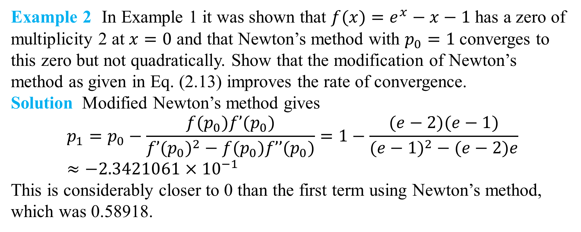
DLI
Example 2 In Example 1 it was shown that $f(x)=e^{x}−x−1$ has a zero of multiplicity 2 at $x=0$ and that Newton’s method with $p_{0}=1$converges to this zero but not quadratically. Show that the modification of Newton’s method as given in Eq. (2.13) improves the rate of convergence.
Solution Modified Newton’s method gives
$$p_{1}=p_{0}−\frac{f(p_{0})f’(p_{0})}{f’(p_{0})^{2}−f(p_{0})f’’(p_{0})}=1−\frac{(e−2)(e−1)}{(e−1)^{2}−(e−2)e}≈−2.3421061×{10}^{−1}$$
This is considerably closer to 0 than the first term using Newton’s method, which was 0.58918.

Slide 10
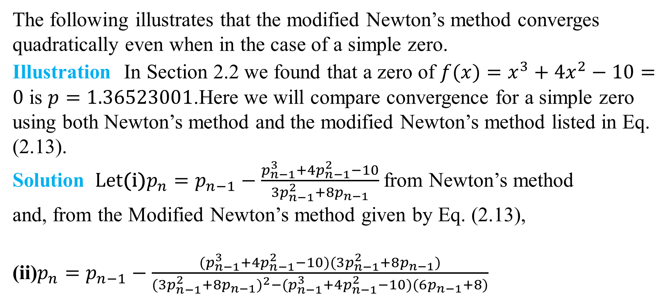
DLI
The following illustrates that the modified Newton’s method converges quadratically even when in the case of a simple zero.
Illustration In Section 2.2 we found that a zero of $f(x)=x^{3}+4x^{2}−10=0$ is $p=1.36523001$.Here we will compare convergence for a simple zero using both Newton’s method and the modified Newton’s method listed in Eq. (2.13).
Solution Let(i)$p_{n}=p_{n−1}−\frac{p_{n−1}^{3}+4p_{n−1}^{2}−10}{3p_{n−1}^{2}+8p_{n−1}}$ from Newton’s method
and, from the Modified Newton’s method given by Eq. (2.13),
(ii)$p_{n}=p_{n−1}−\frac{{(p}_{n−1}^{3}+4p_{n−1}^{2}−10)(3p_{n−1}^{2}+8p_{n−1})}{(3p_{n−1}^{2}+8p_{n−1})^{2}−{(p}_{n−1}^{3}+4p_{n−1}^{2}−10)(6p_{n−1}+8)}$

Slide 11
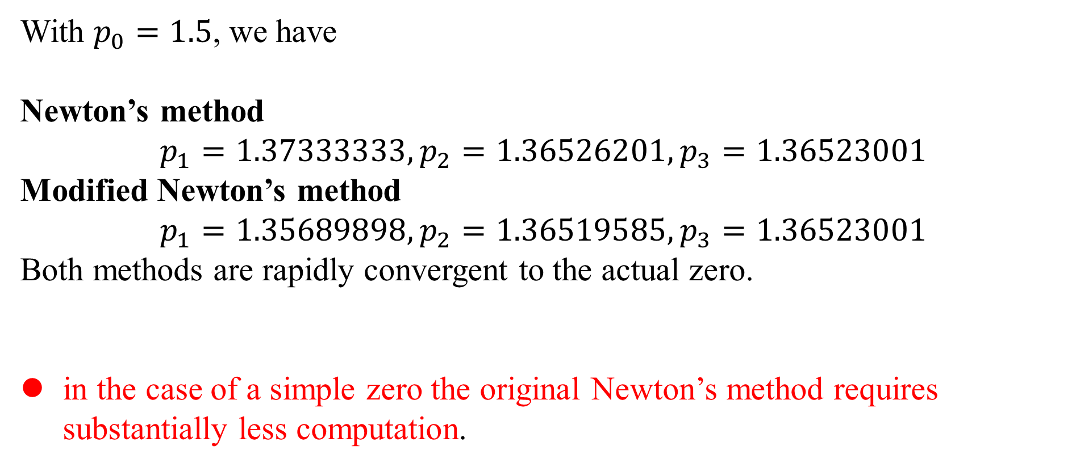
DLI
With $p_{0}=1.5$, we have
Newton’s method
$$p_{1}=1.37333333,p_{2}=1.36526201,p_{3}=1.36523001$$
Modified Newton’s method
$$p_{1}=1.35689898,p_{2}=1.36519585,p_{3}=1.36523001$$
Both methods are rapidly convergent to the actual zero.
in the case of a simple zero the original Newton’s method requires substantially less computation.

